Slide 1
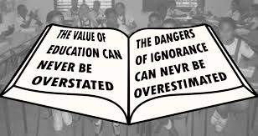

Education & Irob people
Why IDA believes education is a Key
By
Abraha Sibhat
USA
May 1, 2014

Slide 2
Importance of Education
In today’s world, education is considered one of human basic necessities.
Education helps individuals to:
  become informed about the contemporary world.
  develop self-awareness and make informed decisions
  empower self-confidence & personal growth
  thrive economically, become a responsible citizen, and support others.
  and much much more…
As evidenced by ato Adoumer Goish’s prophecy over 100 years ago, “Erro meehirrod, Laa girbbod”, our forefathers recognized the benefits of education long ago.

Slide 3
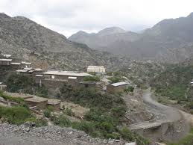
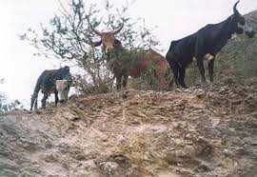
history of formal education in irob
Formal education in Irob has about 160 years of history. First school was opened in 1847 by Lazarist Catholics in Alitena. In present day Ethiopia, Shewa was the only place that had formal education, where it begun in 1830 and existed only for short time. Dr. Pankhurst www.linkethiopia.org/guide-to-ethiopia; also read (SOME FACTS ABOUT IROB www.geocities.com/Background_Irob.html , A Paper Written by Souba Hais Oct. 25, 1998)

Slide 4
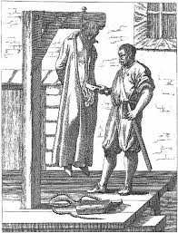
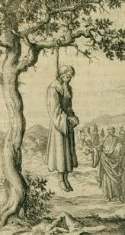
Irob history of formal education continued-
by 1850, it was legally recognized by Dej. Woubie, native of northern Gondar and the then governor of Tigray
curriculums included Geez, Amharic, science and mathematics. As well as Latin, French, philosophy, and theology were taught in higher levels, It is documented that in 1914 alone there were about 500 students in the school
however, history indicates that Lideta School has had many interruptions due to religious persecution in its long history and our ancestors had fought it continuously----

Slide 5
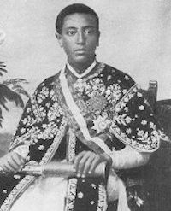
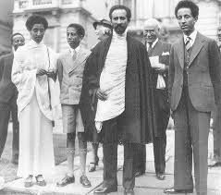
Irob history of formal education continued-
on May 4, 1916 leaders of Buknaiti-Are and the clergy, held a special meeting to discuss solutions to maintain lideta school & the Catholic religion
delegations of four prominent Irobs & a french missionary were sent to showa on foot travel to present their case to Lij Eyasu;
They were
  Mr. Adoumar Halibo,
  Mr. Menelik Woldegiorgis ( my great- grand father)
  Abba Tesfaselasse Woldegerima,
  Abba Gebreigziabiher, and
  a French missionary

Slide 6
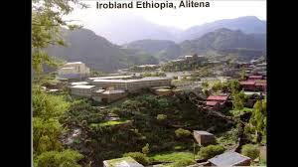
Irob history of formal education continued-
the Delegates were able to talk with Lij Eyasu & received grant letter to pursue their school & religious belief without persecution.
in 1935 Lideta was closed by Italian invaders until 1959 when it reopened from scratch base ( okolli daa-ge kik-tinemko) by Dr. Abba Woldemarianm Khasay.
from then on, Lideta continued to educate thousands of Ethiopians for many years until Eritrean invasion of Irob land.

Slide 7
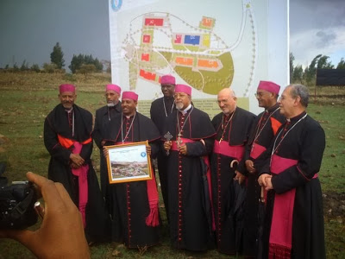
Irob history of formal education continued-
Some of the prominent figures educated in Lideta and served back their communities are:
  Dr. Abba Hagos Fessuh of Alitena - well known scholar and founder of the Catholic school of Dessie
  Abune Haile-Mariam Khasay of Adigrat, the first native Catholic eparch for all of the Ethiopian Empire and founder of the excellent Tsinseta School of Adigrat
  Abune Asrate-Mariam Yemru, the second Catholic eparch of Ethiopia, from Showa
  Dr. Abba Woldemariam Kahsay,
  Abune Yohannes Woldegionrgis
  Dr. Tesfay Debessay-alitena
  And many other scholars, engineers,
  lawyers , current bishops . etc.

Slide 8
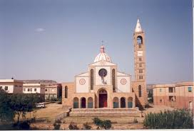
Irob history of formal education continued-
educated irobs (mostly priests & nuns) continued to maintain and promote education in Irob through help of catholic church.
they paid unforgettable sacrifice & efforts for years to educate irobs, though they lacked adequate
resources & technology.
Towards the end of fall of Derg (1989-1990),formal education was not functioning in Tigray except in Alitena. Taking advantage of the occasion, education in Alitena was expanded to include 9th & 10th grades).

Slide 9
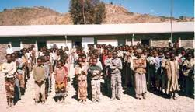
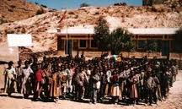
Current educational status in Irob
as Irob visionary parents had forecasted, the farming & pastoral dependency have become almost non-existent.
Today, young Irobs have no other alternatives except to win the academic competition and take education as a survival option.
although access to elementary education in Irob has increased in recent years (both through government and Catholic Church), the percentage of Irob students making to college level education continues to diminish, compared to the rest of country.
Irob schools are ill equipped and lack necessary educational resources, contributing to lack of motivation and diminished academics success of our children.

Slide 10
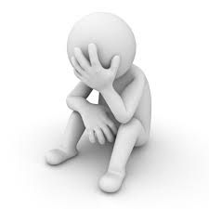
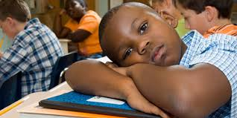

Current educational status in Irob------
recent reports indicated that students earned a passing grade to universities form Irob high school were the lowest in the country( tigray being last in the country & then Irob being the worst in Tigray region)
Irob festival 2006 from Dawhan shows passing rate from 10th grade to preparatory school is decreasing from year to year
the same report also indicated that the main problem being lack of qualified teachers

Slide 11
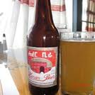
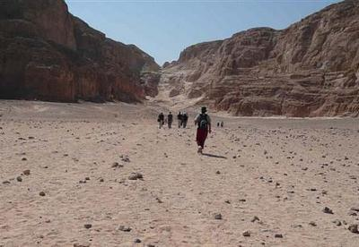
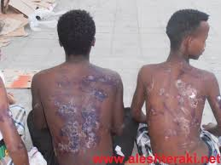
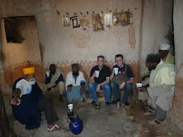
Current educational status in Irob------
Many students abandon school and spend their golden time in local bars drinking alcohol and fist-fight of one-another that results in injury & loss of life
Many take uncalculated risk to travel to various parts of the world through illegal & dangerous journey in search of better living conditions

Slide 12

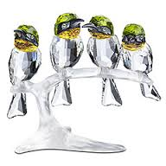
Do we need to do something ?
Yes!!!!!!!!!!!
our forefathers have done their part during those difficult & dark years for us
One way or an other, we are affected by our failing children
We have to send money once they are in the hands of illegal traffickers
      All family to collect money when children get in risk of injury, death , or in prison
      But for how long can we do this??
If our new generation is not supported at their school age, the survival of Irobs as we know it is in danger.
We are morally, psychologically, culturally bound to pay back to our community.
It is imperative that we act urgently.

Slide 13

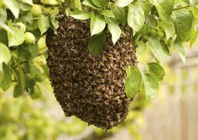
What can we do ?
We, Irobs at home and abroad, can organize & unite our resources to:
make irob schools competitive, modern, and motivate learning by means of equipping schools with badly needed educational materials such as laboratories, computers, libraries or referencing materials, and sporting goods.
promote competition among students to motivate learning by offering scholarship prizes
encourage outstanding teachers by providing additional training, monetary prizes, or other benefits
reclaim Irob’s historic lead in education
unite Irobs around globe for common goal

Slide 14

What can we do ?
I agree there are so many other issues Irobs at home are facing that need to be recon-with.
I believe that we should concentrate our energy in improving education while also working on those other problems so that we create a stable long-term solutions for our people.
Improving educational standard is relatively easy for anyone to get involved and do their share, timely, and a foundation for success of any society.
Education is a key in eliminating all other issues our people are facing.

Slide 15
How can we do it ?????
Irob development association (IDA) has taken Irob education as it’s priority and has been doing its best for the past few years. We can say all what we want about IDA’s accomplishments or short-comings since its inception. The fact of the matter is that we are responsible either way. IDA’s success is ours and we should also own its failures.
IDA is in the process of mobilizing & organizing all Irobs around the globe. And there are good indications that it is going to be successful this time around.
It is high time for all of us to act together on common goals before our community falls-apart. It’s normal to have personal differences & beliefs, but it’s abnormal to take our differences personal and abandon the common goals. Things that matter the most should not be at mercy of things that matter list

Slide 16
conclusion
IDA leadership will present its plans & updates and is not the purpose of this writing.
The focus of this writing is that we, few lucky Irobs:
  have obligation to support the community that has given us opportunities to our present life,
  have to preserve our historical long sighted & visionary forefather’s hard work & dreams
  should act and thrive together or fail together
  should do what is in our power to prevent our community and culture from vanishing
  Take ownership of the degrading situation in Irob, take the high road and act upon finding solutions to save ourselves from moral embarrassment.
If we fail to act as one and urgently, we will continue to receive calls from our relatives who take risky travels, we will keep hearing more & more social crisis from home, the slow degradation of Irob culture and language will continue, and all these failures will happen just because we fail to act together on remediation plans.

